Slide 1
Microsoft Cloud University Azure Fundamentals – Compute, Storage, Migration and Data Protection
Manavi Banerjee
Senior Cloud Solution Architect
mabanerj@microsoft.com

Slide 2

The Ground Rules
Here to learn
Safe environment to ask your questions
No such thing as a stupid question
No one knows everything
Fun and interactive
Try to answer / guess

Slide 3
Agenda
Virtual Machines
Storage
Migrate to Azure
Data and VM Protection

Slide 4
Virtual Machines

Slide 5
Virtual Machine Concepts
VMware/Hyper-V
Smaller footprint
Reduced management
Less power
Less cooling
Less hardware needed
VM1
VM2
VM3
SQL Server 2012
Finance
Application
Procurement
Application
VM4
VM5
VM6
SQL Server 2016
HR
Application
Active
Directory
Storage
(Files/VM Disk drives/Data)
Hypervisor (VMware/Hyper-V)
Server Hardware (HPE/Dell)
X#CPUs/X#RAM
Network
Notes:
https://azure.microsoft.com/en-gb/overview/what-is-a-virtual-machine/
VM, is no different than any other physical computer like a laptop, smart phone, or server. It has a CPU, memory, disks to store your files, and can connect to the internet if needed. While the parts that make up your computer (called hardware) are physical and tangible, VMs are often thought of as virtual computers or software-defined computers within physical servers, existing only as code.

Slide 6
What are Virtual Machines?
VMware
Introduced in early 2000s
Put multiple computers inside a physical computer
Each VM behaves like a computer that is inside another computer
The physical server uses a piece of software called a Hypervisor to manage them
Hyper-V
Owned by Microsoft
Launched in 2008
Pretty much the principle as VMware
Both plug into a shared storage (SAN – Storage Area Network)
Think of it like a hotel!!
Hypervisor = reception
VM = hotel room
Network = internal hotel room phone system
Storage = restaurant
Notes:
Vmware and hyperV are hypervisors. With Hyper-V, multiple virtual machines can be run on one computer, each with its operating system, enabling VMs to operate side-by-sid

Slide 7
The Business Need for Virtualisation
Reduce the number of physical servers
Easier to manage and control
Increased flexibility on server sizes (virtual)
Faster deployment times for new server's vs building/buying a new physical one
Reduction in costs;
Power
Cooling
Infrastructure

Slide 8
Most comprehensive resiliency and best SLA
INDUSTRY-ONLY
INDUSTRY-LEADING HIGH AVAILABILITY SLA
INDUSTRY-LEADING DISASTER RECOVERY
VM SLA
VM SLA
VM SLA
REGIONS 65
99.9%
99.95%
99.99%
Region 1
Region 2
SINGLE VM
AVAILABILITY SETS
AVAILABILITY ZONES
REGION PAIRS
Protection with Premium Storage
Protection against failures within datacenters
Protection from entire datacenter failures
Protection from disaster with Data Residency compliance
Notes:
Resiliency: Ability to remain up and running in case of any hardware or service failures.
Availbailty set: logical Construct to place the virtual machine in a setting that at a time all the VMs in the Av set doesn’t have any planned or unplanned outages like maintenance.
SLA: a 99.99% SLA is allowed a little under 1 hour downtime in a year. 99.95% meaning around 4.5 hrs in a year downtime, 99.9 = 8 hours 45 mins / year.

Slide 9
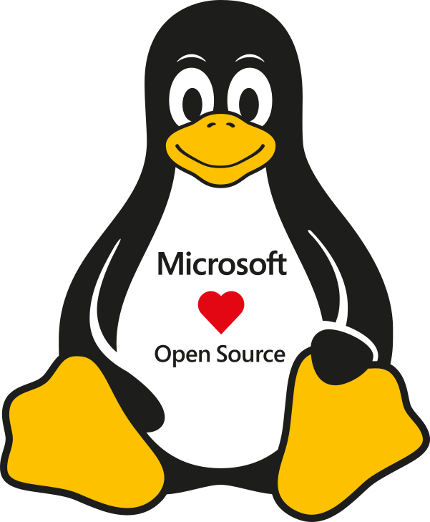

Linux, Open Source, and Red Hat
40% Azure VMs running Linux
60% of solutions in Azure Marketplace Linux based
Strategic partnerships with OSS providers
In-portal customer experience for PAYG deployments
Co-located support with Red Hat on-site team
Integrated support, available 24x7
Notes:
An operating system (OS) is system software that manages computer hardware, software resources, and provides common services for computer programs. acts as an interface between the software and different parts of the computer or the computer hardware. Runs on top of physical servers. On top of OS runs the hyperV software.

Slide 10
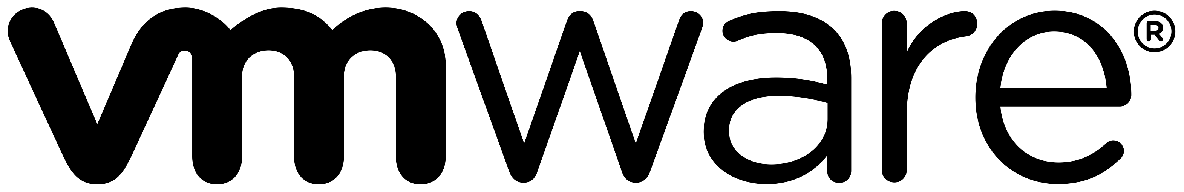

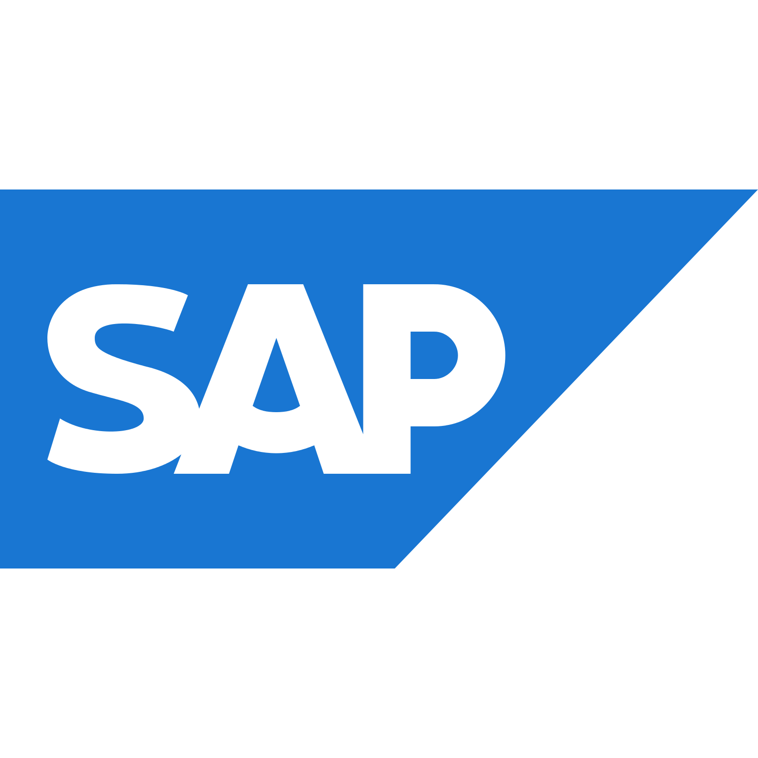

Beyond on-demand infrastructure
Purpose-built infrastructure for specialized workloads
On-demand infrastructure

Slide 11
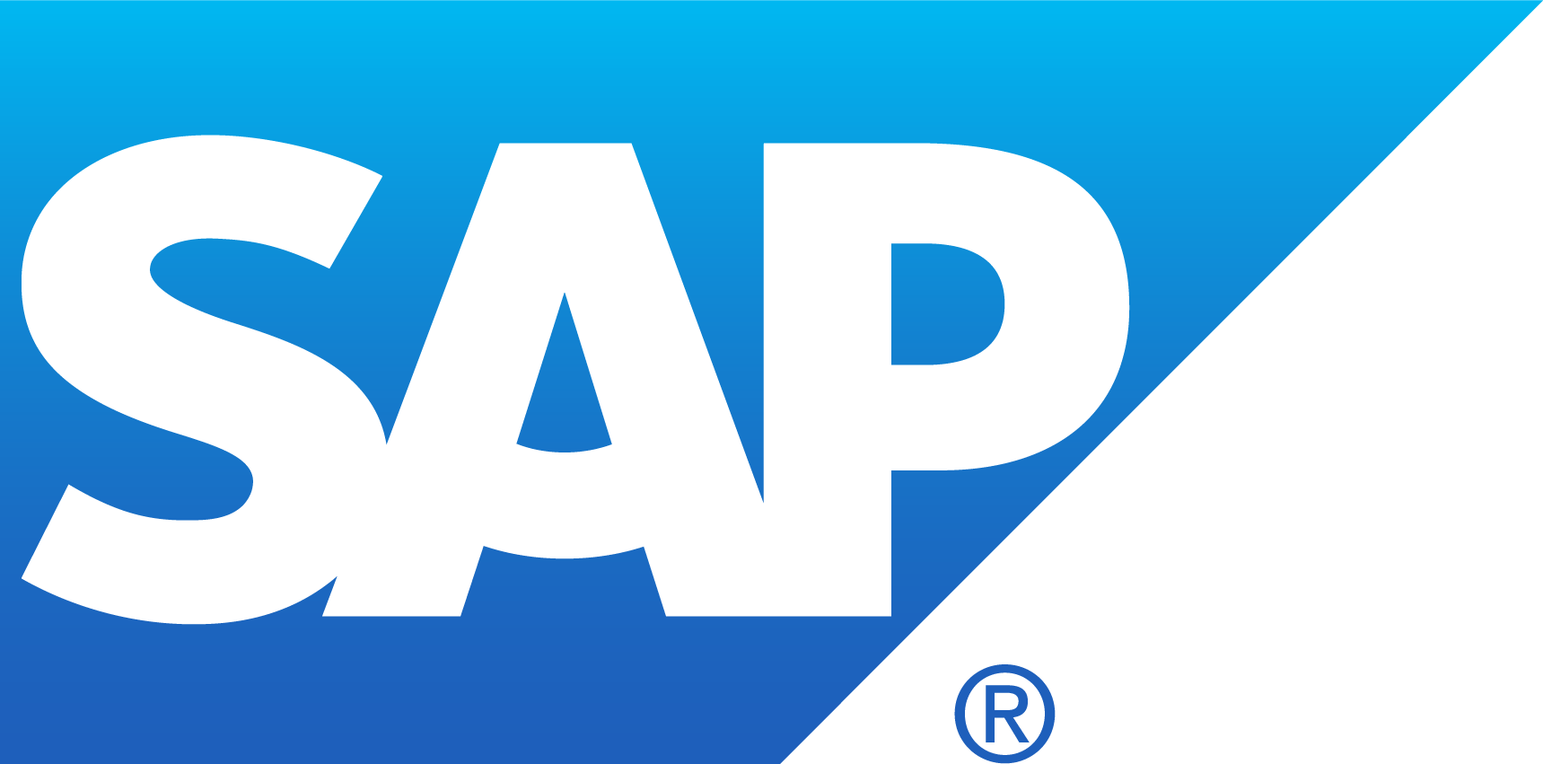
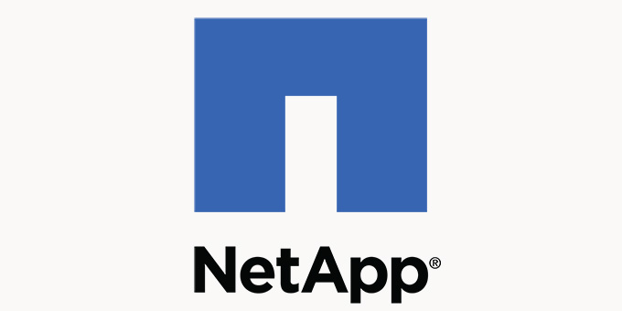
Azure Virtual Machines and Azure Dedicated
VIRTUAL MACHINES
PURPOSE-BUILT
Entry level [A]
Burstable [B]
General Purpose [D, DC]
Compute intensive [F]
Memory optimized [E, M]
Storage optimized [L]
GPU accelerated [N]
High Performance Computing [H]
Notes:
ACC, Dedicated
Azure VM Comparison (azureprice.net)
Virtual machines in Azure - Azure Virtual Machines | Microsoft Learn
Burstable: B-series VMs are ideal for workloads that do not need the full performance of the CPU continuously, like web servers, proof of concepts, small databases and development build environments.
GPU N series: designed for compute-intensive, graphics-intensive, and visualization workloads.

Slide 12
Storage

Slide 13
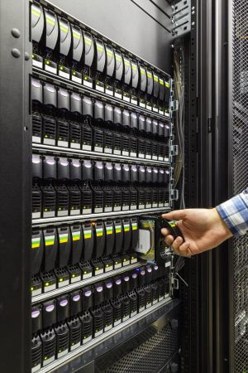




What is Storage?
A disk where all your files/folders/information is kept.
Stored where the server can access them quickly across a network.
A laptop will typically have one hard disk
Group multiple hard drives together and spread data across them. It is called a RAID. (Redundant Array of Independent Disks)
A SAN is a collection of hard drives managed by storage software
SQL Server
App 1
Active Directory
SQL Server
1 GB Storage
Network
SQL Server
2 GB Storage
1PB Storage
SAN Storage
SQL Server
40 GB Storage
Notes:
Cover off RAID etc in CP Level 200

Slide 14
Secure, scalable and highly available storage options for every use case
Disk Storage
Object Storage
File storage
Premium
Standard
Azure Blobs
Azure Files
Azure NetApp Files
Reliable, persistent, high performing storage for Virtual Machines
Secure, centralized storage target for backup/disaster recovery
Lift and shift of legacy applications that require file shares to the cloud
Data Transport
Hybrid Storage
Azure Import/Export
Azure DataBox
Azure StorSimple
Azure File Sync
Avere*
Move or migrate data into Azure
Secure, intelligent data tiering between on-premises and cloud storage

Slide 15
Azure Disks
Performance Tiers
Simplified Management
Resource Group
Managed Disks Highly available and scalable
Premium SSD Disks Provisioned performance for Enterprise Prod
Standard SSD Disks Cost effective performance for entry-level workloads
Standard HDD Disks HDD based, cost effective for dev-test workloads
Industry leading ZERO % Annual Failure Rate
Best in class VMs with
High IOPS/BW
< 1ms latency for cached operations
Developer Support
REST API Support
Easy Migration / DR / Backup
Rich partner ecosystem
Enterprise grade durability with 3 replicas
80,000 IOPS & 2,000 MB/s
Disk throughput per VM
Blob Cache technology
Up to 160,000 IOPS

Slide 16
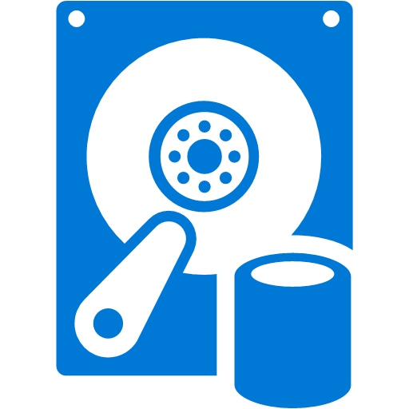
Virtual Machine Disk Storage
Virtual Machine OS and Data Disks exist within Azure Storage service
Azure Storage
Resource or temporary disk exists in hypervisor local storage
You can mix Standard and Premium disks if required
C: OS Disk (2 TB)
D: Local Temporary Storage
F: Data Disk (500 GB)
G: Data Disk (4 TB)
Beware: Data on the D:\ Drive can/will be lost when a machine is moved or deallocated
Notes:
++Ephemeral OS disks
The key features of ephemeral disks are:
Ideal for stateless applications.
Lower latency, similar to a temporary disk.
Ephemeral OS disks are free, you incur no storage cost for OS disk.

Slide 17
Azure Storage Durability
Typically >300mi
Typically >300mi
Async
Async
Primary
Secondary
Primary
Secondary
LRS
3 replicas, 1 region
Protect against disk, node, rack failures
Write is ack’d when all replicas are committed
Superior to dual-parity RAID
GRS
6 replicas, 2 regions (3/region)
Protects against major regional disasters
Asynchronous to secondary
RA-GRS
GRS + Read access to secondary
Separate secondary endpoint
RPO delay to secondary can be queried

Slide 18
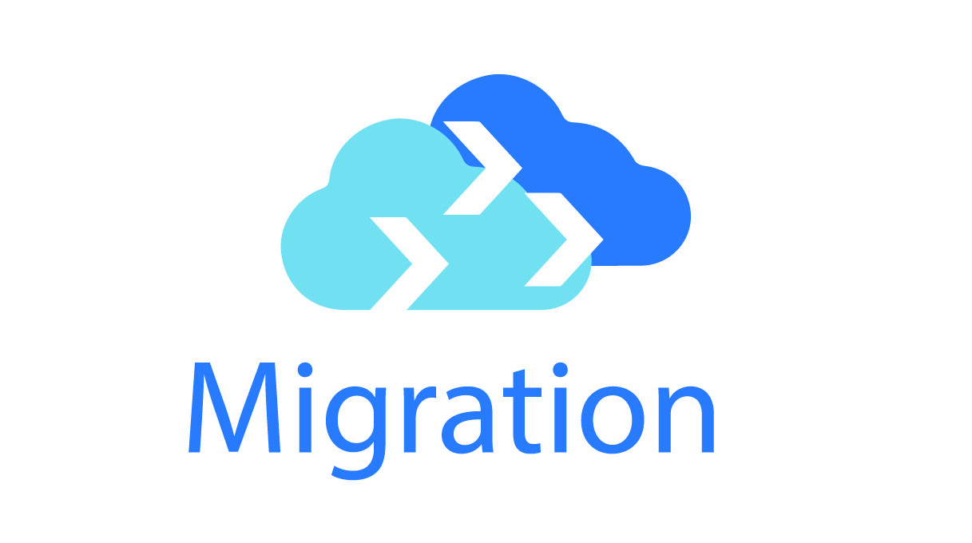
Azure Migration

Slide 19
Azure Migrations
Moving from On-Premise to Azure
Software assessment to see what is on-premise
Agents downloaded to gather data
What can be lifted and shifted into Azure or modernize by moving to Azure
Right size VMs vs Like for Like
Shows ballpark costings and what it will be like in Azure for VMs and Storage
Migrates both VMware and Hyper-V servers and physical servers into Azure.
Customers can then shut down on-premise VMs.

Slide 20
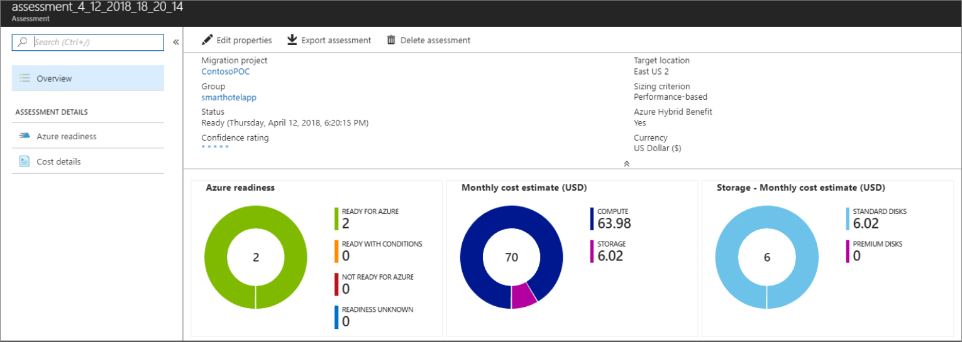
Azure Migrate

Slide 21

Quiz!
What hypervisors can Azure Virtual machines work on?
VMware and Hyper-V
True or False: Can we migrate physical Servers into Azure?
True
3. What type of redundancy azure storage has?
A. LRS, GRS and RA-GRS

Slide 22

Data Protection and Backup

Slide 23
Data and VM Protection…
Backup
Takes a copy of your data
Moves the copy to another location
If an issue on your VM occurs, you can do a restore
Can restore the whole VM or just a single file/folder
BCDR (Business Continuity Disaster Recovery)
Replicates your VMs to another location
Keeps the VM replicated frequently.
If an issue on your VM occurs, You can fail over to that location.

Slide 24




Data and VM Protection – Backup
Backup to Azure
Keep for 30 days
Backup to local SAN
Customer Site
Long term archive backup to off site location

Slide 25
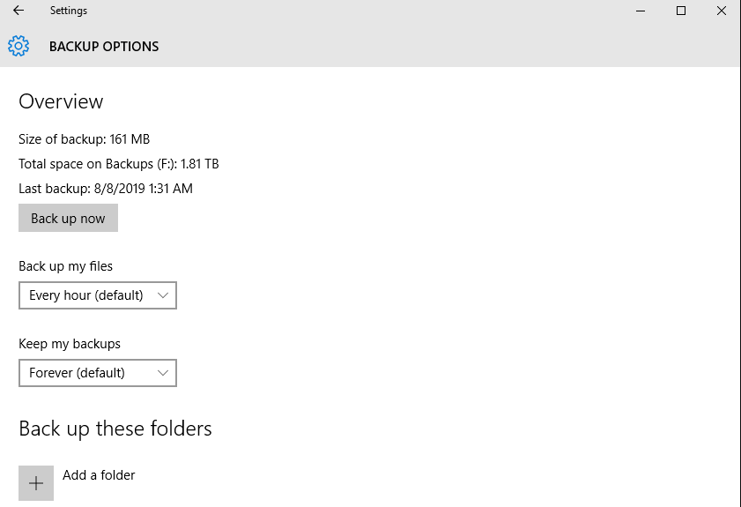

Slide 26

Data and VM Protection – Disaster Recovery
Replicate to Secondary site
Failover to Azure
Customer Site - Primary
Failback to Primary Site

Slide 27
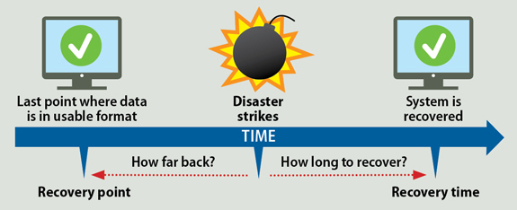
Business Continuity and Disaster Recovery

Slide 28
Business Continuity and Disaster Recover
How to recover from a BCDR incident?
What to recover first?
Service Level Agreements to be clarified and met.
For example:
Platinum (must keep going or recover first – lowest RPO/RTO)
Gold (Next to recover – within 12 hours)
Silver (Next to recover – within 24 hours)
Bronze (Next to recover – within 36/48 hours)

Slide 29
In a nutshell…..
What does a backup do?
Takes a copy of your data and stores it elsewhere.
What does BCDR stand for?
Business Continuous Disaster Relief
Business Continuity Disaster Recovery
Backup Continuous Data Recovery
When does a Father backup occur?
Once a week
In Azure, how do you backup a VM?
Click on the VM > Backup.

Slide 30
Summary
Azure is a massive global DC that public and private customers can use
Virtual machines and storage are azure services.
Azure Migrate helps move customers on-premise estate into Azure.
VMware and Hyper-V are hypervisors, Azure supports both.
Regularly back up your data to protect it.
Every business needs a BCDR plan and to test it frequently.
RPO and RTO times can help a business get back up and running.

Slide 31
Thank you

